Slide 1
Cloudflare One
Customer Presentation
A SASE network transformation
Notes:
[Introduce yourself]
Core pitch talk track (21 words, 0:10 minute)
Thanks for the opportunity to share with you how Cloudflare can help transform your corporate network to meet today’s business needs.

Slide 2




Cloudflare at a Glance
Cloudflare Zero Trust Services
Cloudflare Network Services
Cloudflare Application Services
1
Cloudflare One
Zero Trust platform
WAN-as-a-Service
WAF with API Protection
ZTNA with Private Routing
Firewall-as-a-Service
Rate Limiting
Remote Browser Isolation
L3 & L4 DDoS Protection
Load Balancing
SWG with CASB
Network Interconnect
Bot Management
Identity/Endpoint Integration
Smart Routing
L7 DDoS Protection
CDN and DNS
Cloudflare Edge Developer Platform
Workers
Workers KV
Pages
Durable Objects
Video Streaming
Cloudflare Global Network
Global Edge: 250+ cities, 95% of population within 50ms, 10000 interconnects, 121 Tbps capacity, China Network
Building Blocks: SSL/TLS, mTLS, Authoritative/Recursive DNS, DNSSEC, DNS over HTTP, L4-7 over Wireguard
Compliance/Privacy: FedRAMP, ISO, SOC, PCI, GDPR compliant, Logs & Analytics, Data Localization Suite
ZTNA = Zero Trust Network Access | SWG = Secure Web Gateway | CASB = Cloud Access Security Broker
Notes:
Slide goals:
Answer: What is Cloudflare? Aren’t you a CDN? What do you offer for SASE?
Primer to describe the company with prospects unfamiliar with us, or customers who only know us or use us for limited application services (CDN/WAF/Bots) today.
Explain that CF1 is the combination of Zero Trust and Network Services.
Core pitch talk track [90 words; 0:35 minute]
A lot of people know us for our application services but, Cloudflare is, fundamentally, a network.
We started by building a network in 250+ cities around the world.
Today that network provides one consistent architecture for all of our services with unbeatable global performance and security built-in.
Cloudflare One brings together Zero Trust security services with networking services deployed on that edge
And it’s built using our own developer platform for unrivaled cost efficiency and pace of innovation.
While other vendors are stitching together SASE platforms through a series of acquisitions or shifting virtualized applications into third-party clouds, each of our services are built from the ground up.
More notes:

Slide 3
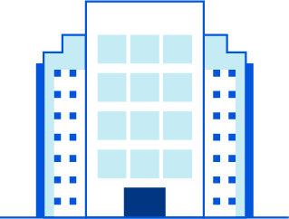
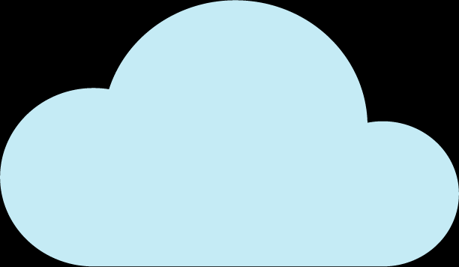

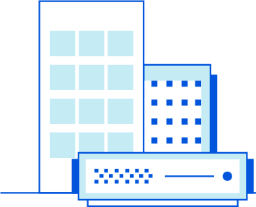


Perimeter-based security models are breaking under pressure
Secure Access Service Edge (SASE)
Today’s corporate network
Optimized security and connectivity
MPLS
Full Mesh
Internet Apps
Office
Internet Apps
Offices
MPLS
MPLS
Data Center
MPLS
MPLS
MPLS
Bottleneck
Office
Self-Hosted Apps
Data Centers
SASE
Self-Hosted Apps
Direct
Breakouts
VPN
Data Center
Remote User
Remote Users
SaaS Apps
SaaS Apps
Notes:
Slide goals:
Show that we understand the key problems prospects are dealing with
Introduce Secure Access Service Edge (SASE, pronounced “sass-y”) as a relevant architecture and strategy to secure and streamline their corporate network.
Preview why we believe that Cloudflare is the best provider to enable a SASE architecture
Core pitch talk track [172-182 words; 1:20 minute]
As workforces and applications exist in hybrid states along with rapid SaaS adoption, most companies we speak with are finding that their perimeter-based security approaches are breaking down.
They’re seeking more consistent and cost-effective ways to connect users, offices, and data centers to applications, with neither the complexity of backhauling through VPNs, MPLS circuits and firewalls nor the lack of visibility from split-tunneling traffic.
We know that using a Secure Access Service Edge will not convert your network from the diagram on the left to the one on right overnight. The more specific demands you have, the more years it will take.
Whether or not you explicitly have a SASE strategy or desire simplifying your network to this degree, we believe Cloudflare has the most complete, performant, easy to use solution for enterprises to help optimize and secure some or all of your corporate network.
In the next 15 [or 20] minutes, we’ll explain Cloudflare’s offering, why it’s better than others, and our recommended approach for adopting SASE at your own pace. [Then, demo Cloudflare’s user interface and end-user experience.]
More notes:
Gartner has proposed a Secure Access Service Edge architecture that consolidates networking and security services and delivers them from a converged service on a cloud-based edge network.
SASE is really about securing traffic to 3 types of applications: first, the applications you don’t control, the public Internet. second, the applications you own and host your self in your data centers. And finally, the applications you rent from SaaS providers.

Slide 4
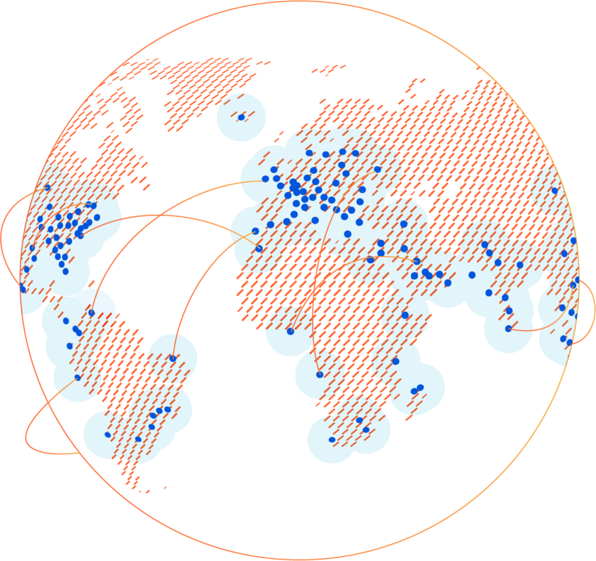
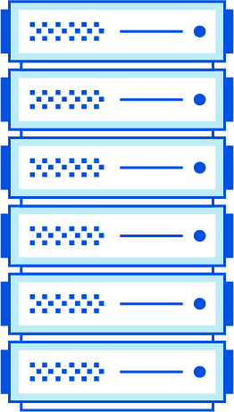

Cloudflare One
We deliver a faster, more reliable, more secure Internet
[network scale] 121 Tbps of network capacity with 10,000 interconnects and millions of internet properties
[network speed] <50ms from 95% of internet users
[cost-efficient innovation] 100% uptime SLA
`
Runs every
Cloudflare service
In every Cloudflare server
In every Cloudflare data center
Across 250 cities in 100+ countries
Notes:
Slide goals:
Our unique advantage
Communicate the speed, scale and reliability of our network.
Core pitch talk track [120 words, 0:45 minute]
When you use Cloudflare One, you’re putting our entire global anycast network in front of yours.
And using it to build your private network on the internet.
Our security services are standardized across our entire network, with every service running on every server, in every one of our data centers around the world.
That means we can offer single-pass-inspection of requests that’s lightning fast, and consistent for users no matter where they connect from.
We have 10,000 network interconnects with ISPs, SaaS providers, and we’re highly co-located with Microsoft, Amazon, and Google.
So when users hit our edge requesting content from those providers (roughly one-eighth of the internet) it’s located right next to, even on the same metal, as our security capabilities.
Our scale, combined with the speed and reliability of our routing, allows Cloudflare to provide customers with a 100% global uptime SLA.
More notes:

Slide 5
Cloudflare One is a SASE network transformation
Cloudflare One
Cloudflare Services
Zero Trust Network Access
Secure Web Gateway
Firewall as a Service
WAN as a Service
Single-Pass Inspection
Identity Proxy
Device Posture
Browser Isolation
Data Protection
DNS/HTTP Filters
Threat Protection
DDoS Protection
Analytics
Private Routing
Load Balancing
Simple Interoperability
Cloudflare Global Network
Single-Pane Management
Cloudflare Onramps
Clientless Access
Device Client
IP Tunnels
Direct Connection
Notes:
Slide goals:
Cloudflare One overview slide
Demonstrate our vision for getting the customer’s remote worker, office and data center traffic to Cloudflare’s edge
Communicate the security functions we can perform at our edge
Feel free to customize this slide with what you know about the customer’s environment
Core pitch talk track [165 words, 1:10 minute]
Cloudflare One transforms your network by providing onramps for all your sources and destinations of traffic to our global network.
Regardless of the onramp, traffic is routed and accelerated over the fastest North-South and East-West path over our private backbone -- at the same time every request and login passes through every Cloudflare Zero Trust security service and network connectivity service in one pass.
Onboard any user or device in minutes with secure browser-based clientless access to applications.
Onboard devices on all popular OSes with secure client-based access to any application, private network, or Internet destination.
Onboard entire public and private IP subnets via IP tunnels from your existing routers, or our own IP Tunnel connector.
Or even onboard your network infrastructure directly at colos — rather than over the public Internet.
Start with 1 key Cloudflare service, such as Zero Trust Network Access, or many. Many Cloudflare services support one another to enable policies managed in one pane that verify, filter, isolate and inspect traffic.
More notes:

Slide 6


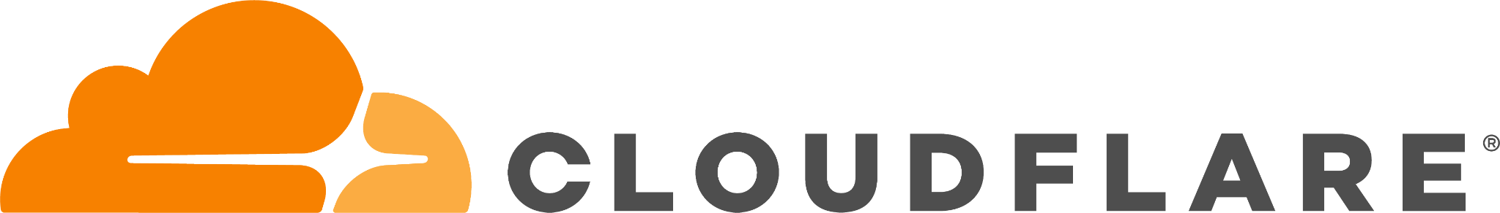



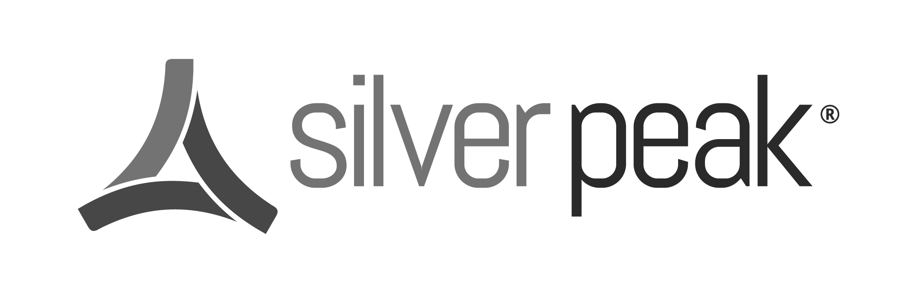

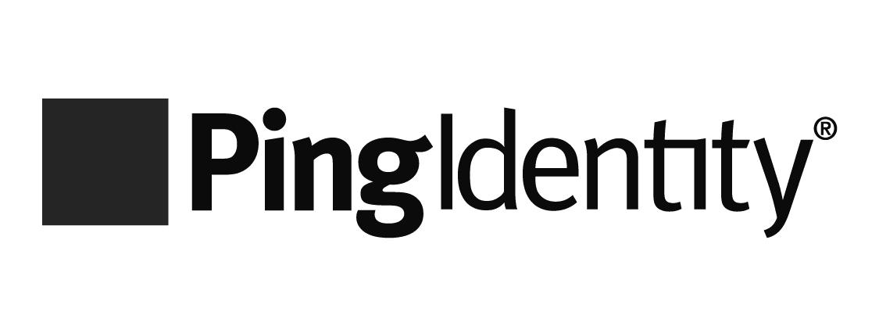

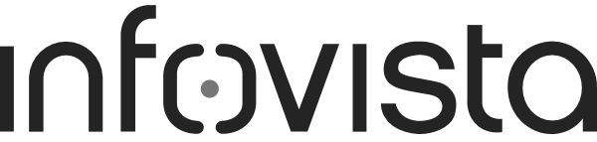
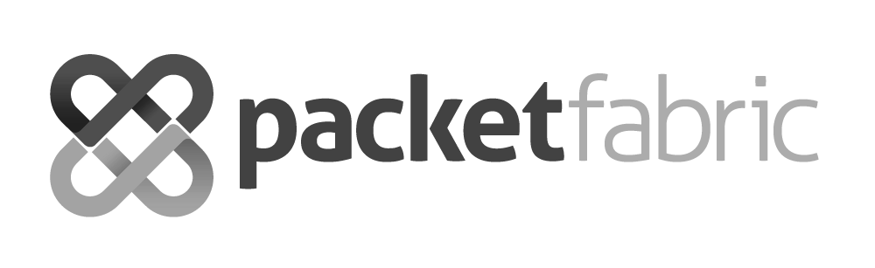
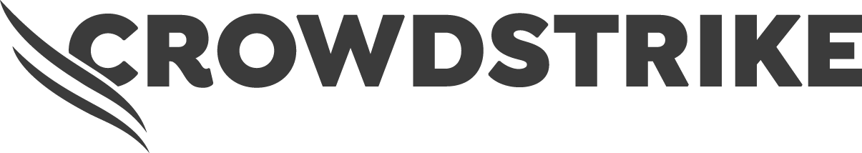

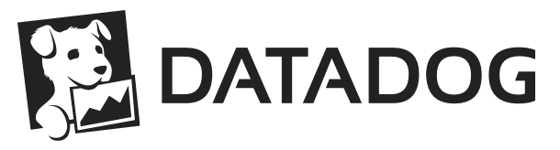
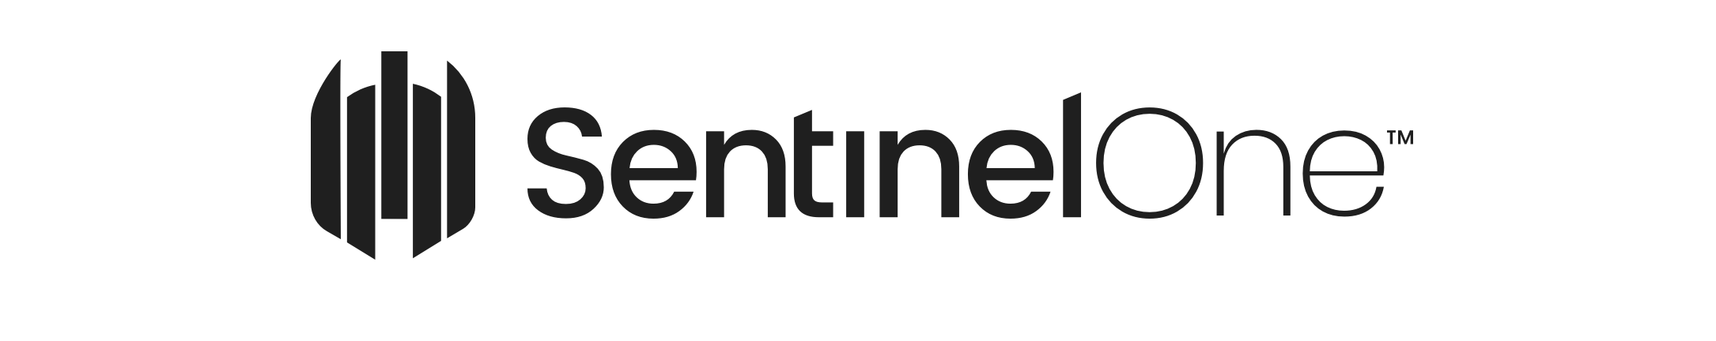
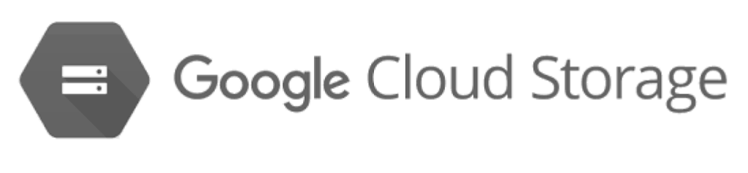



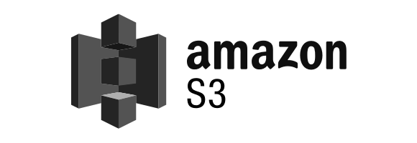



Integrates with your identity, endpoint, log, and network onramps
Cloudflare One
Network Onramp Partners
Identity and Access Management Partners
[ease of use] Concurrently use all providers to federate identity and aggregate user auth or device posture signals
[cost-efficient innovation] 1,600+ partner locations can be used to reach Cloudflare’s network
[network speed & scale] Cloud-agnostic; 50+ private interconnects built-in with Microsoft, Amazon, Google
Network interconnect
and IP transit
Identity/endpoint-agnostic
many more
Single-pass inspection
many more
Endpoint Protection & Management Partners
Single-pane management
Log Storage and SIEM Partners
device
client
Programmable interface
many more
many more via S3
Notes:
Slide goals:
Show customers how Cloudflare One integrates with the most critical adjacent technologies they use today
Talk about how having these integrations helps them with fast deployment
We are a cloud and identity-agnostic network enforcement layer.
Core pitch talk track [131 words, 0:55 minute]
We’re cloud, identity, and endpoint agnostic.
Cloudflare One integrates with the vendors you already use.
To enforce user- or role-based zero trust access controls and filters to internet, SaaS or self-hosted apps, we federate identity with up to 5 providers like Okta and Active Directory.
To get your office and data center traffic to Cloudflare, we’ve partnered with 15 leading SD-WAN and colo connectivity providers like VMware and Equinix.
To enforce Zero Trust based on device posture context, we’ve partnered with endpoint protection providers like Crowdstrike and SentinelOne.
Finally, we can push activity logs wherever you prefer to keep them, whether it’s a SIEM like Splunk or a cloud storage bucket like Amazon S3.
Unlike using point solutions, set up each integration just once, and reuse it across many use cases.
More notes:

Slide 7















Journey to SASE: optimize your network at your own pace
Cloudflare One and SASE
Journey to SASE: optimize your network at your own pace
STEP 1-3
Start with ZTNA
STEP 4-6
Modernize Internet Breakout
STEP 7-10
Transform Networking and Security
Phase out legacy VPN for 3rd party access
Retire legacy VPN for remote access
Consolidate SWG, CASB, ZTNA & RBI as contracts renew
Phase out network security appliances & private circuits
Eliminate private circuits
*org is planning now
1
2
3
4
5
6
7
8
9
10
Adopt zero trust security posture for remote work
Strengthen sensitive data visibility and control
Adopt zero trust security posture for office locations
Secure app-to- app connectivity across a hybrid cloud environment
Embrace full zero trust security posture
Security Policy
Infrastructure Consolidation
Notes:
Slide goals:
For customers who are casually interested in exploring SASE and say they don’t know where to start
Aligns customer stories to the recommended milestones to show how we are helping other customers
*You may want to stop at step 5 to keep it simple and transition to next slide
Core pitch talk track [262 words; 1:45 minutes]
Prospects often feel overwhelmed working through the SASE model, so we’ve broken down a common journey path where each step builds on one another incrementally.
We recommend starting where retailer Kathmandu did; deploying Zero Trust Network Access to 3rd party contractors for simple, fast connectivity to their apps without a VPN.
Then, like graphic design platform Canva, take the lessons learned from your contractor deployment and apply a Zero Trust Network Access approach to your entire remote workforce[1].
Next, replace the VPN by retiring non-web or thick-client application use cases; even applying a Zero Trust approach where you need to maintain a private routing model.
The journey continues as you consider how to protect sensitive data within applications, like media company Politico did[2].
Once you’ve strengthened access controls, turn your focus to applying a Zero Trust approach to Internet browsing and activity within SaaS applications.
Doing this will make standalone SWG and CASB redundant, so take note of when contracts expire, and find opportunities to leverage the Cloudflare One Zero Trust capabilities to replace them.
At this point, turn your attention back to your office locations and how you can securely enable direct internet breakouts while maintaining the same East-West transport performance.
This can allow you to phase out private circuits from offices to data centers as well as network security appliances.
Last up is connecting your data centers together with public cloud providers, which would allow you to eliminate private circuits entirely.
We offer a consolidated Zero Trust security platform to help you achieve steps 1 through 5
More notes:
For Canva, that meant deploying a consistent login experience to self-hosted applications that currently require a VPN for access.
Politico deployed our Zero Trust security products to protect sensitive content within their CMS systems on a resource-by-resource basis.

Slide 8
Adopt Zero Trust application access and Internet browsing
Cloudflare One
[network speed & speed]
Single-pass inspection for secure, fast, reliable, private connectivity
[ease of use] Single-pane management unifies ZTNA, VPN/FWaaS, SWG, RBI, CASB and DNS
[cost-efficient innovation] Reduced spend on IT tickets and security solutions
Zero Trust platform
Internet Apps
Internet
gateway
Browser
isolation
Self-Hosted Apps
Any User
Secure
access
SaaS Apps
Notes:
Slide goals:
Introduce Cloudflare’s Zero Trust security platform (aka Cloudflare Zero Trust)
Talk about how we help them apply a zero trust security framework to both application access (ZTNA) and Internet browsing (SWG).
Core pitch talk track [133 words; 0:50 minute]
Zero Trust security means that users are no longer inherently trusted to connect to corporate resources based on that they’re on-network, such as with a VPN connection.
And unknown web code is not inherently trusted to run on an end-users’ device based on coming from a known site
Our platform will eliminate complexity, increase visibility, and reduce risk for every request and login remote workers make to any resource, whether IT owns it, rents it, or if it’s out there on the Internet with no ability to control it at all.
Customers can reduce time spent on IT tickets by 80% and reduce their attack surface by 91%.
It all works together with one policy builder to be easy to use in under 30 minutes, and one architecture for a faster end-user experience.
More notes:
While other vendors have ZTNA and SWG services, they often host them in different data centers around the world. With Cloudflare Zero Trust, all of our security and performance features happens with one single-pass inspection, so it’s incredibly fast for end users.
You can allow/block DNS and HTTP requests according to your policy rules, and keep employees from running into threats on the Internet, with a secure web gateway.
But no secure web gateway can stop every attack, so we add additional threat defenses by isolating remote users’ browsing session in a secure container in the cloud.
This protects their devices from from unknown threats, and soon, you’ll be able to implement even more browser-specific controls granular controls to stop data loss like blocking copy/paste, print, form fill, within a site.
Finally, we enforce Zero Trust application access to corporate applications, whether you rent or own them yourselves.
Instead of “trusting” that users on the VPN, or with a specific IP address, should be able to connect to your applications, Zero Trust Application Access lets you to implement consistent, identity and context-based policies for application access.

Slide 9
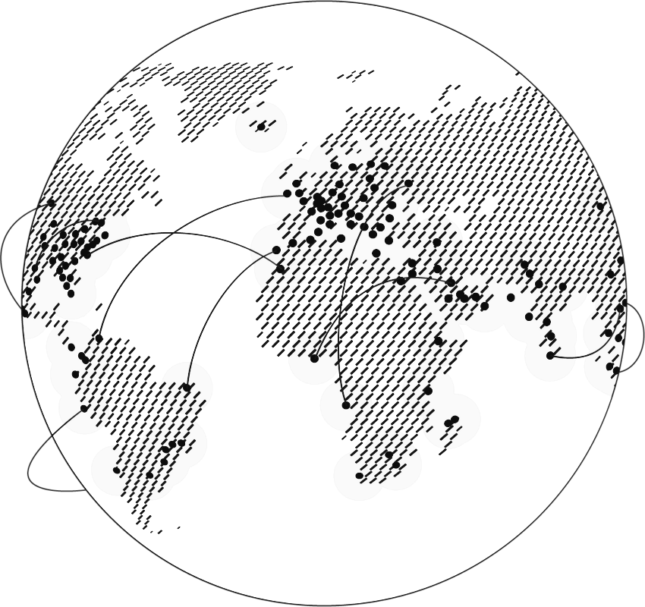
Comprehensive coverage against Internet-borne threats
Cloudflare One
Intelligence based on our machine learning
Intelligence based on our ecosystem
CORE
CORE
<500ms updates
Threat hunting using our network data
EDGE
Telemetry from 4.2M+ customers and 250+ locations
Threat aggregation across our partners
1T+ DNS requests resolved per day with no sampling
Premium third-party feeds
OSINT and shared feeds
Millions of Internet properties
10,000+ network interconnects
<500ms updates
Community-provided feedback
Security risk categories to block, isolate or logpush to SIEM per policy rule
Malware
Phishing
Cryptomining
Newly seen domains
New domains
Unreachable domains
DGA domains
DNS tunneling
C2 & botnet
Spyware
Spam
Anonymizer
Notes:
Slide goals:
- Demonstrate our threat intelligence and how it can protect their environment
- Threat intel is consumed by customer via 13 security risk categories they can automatically block or isolate in Cloudflare Zero Trust
- We apply machine learning to our own data; no cherry picking limited samples
Core pitch talk track [151 words; 1 minute]
We protect the data accessed by your workforce and network against threats using the intelligence that we aggregate from our own network, and our ecosystem of partners.
Cloudflare has a massive amount of Internet properties and interconnects across our network to map traffic and IP patterns across the global Internet to stop DDoS attacks.
But we’re also resolving billions of DNS requests per day, which enables us to learn newly seen and new domains before others.
These risky domains may distribute new malware, host new phishing sites, and command & control or exfiltrate data from newly-compromised devices.
We’ve trained machine learning models to hunt for threats inside the Internet traffic we see, and we categorize those insights into the security risks highlighted in blue.
Combined with other feeds, administrators can block or isolate 13 security risks the same for the entire workforce or differently per user group in a few easy clicks.
More notes:
Cloudflare’s resolvers see over 1T Domain Name Server (DNS) requests per day across our products for businesses and consumers.
Unlike other vendors, we never sample those requests, which means we don’t cherrypick small portions of them for analysis in our machine learning models.
We use this data to flag domains the first time that we see them registered, and the first time we see them resolved.
For instance, a newly resolved domain may indicate a potential risk or gray area customers may want to block. The newly seen domain security risk category can be isolated or blocked to mitigate potential risks.
We can determine whether those new domains are being generated by domain generation algorithms spitting out new variations of domains to evade traditional filters, and we provide that as another category for you to block.
Using our machine learning models we can also determine whether the domains are really malware exfiltrating data using an algorithm called DNS tunneling, another security risk category you can block.

Slide 10
Zero Trust Network Access with Private Routing
Cloudflare One: Zero Trust services
[ease of use]
Same security and experience accessing legacy non-HTTP apps as modern apps
[network speed & scale]
Built-in, industry-leading DDoS & FW protections to ensure that your resources are always available
[cost-efficient innovation]
Unify network and cloud access in minutes
Verify every login and request
User
WHAT
HOW
Resource
Multiple identity providers
Firewall protected private routing
wireguard tunnel
Cloudflare Tunnel
Self-hosted apps
Client on device
Device security posture
DDoS protected reverse proxy
Internal IPs and hostnames
Contextual factors
In-browser terminal
Clientless
HTTPS
Identity
proxy
SaaS apps
Zero Trust Network Access
Secure Web Gateway
Firewall as a Service
WAN as a Service
Browser Isolation | DDoS Protection
Notes:
Slide goals:
Cloudflare Access overview
Customers may know us for protecting HTTP or web applications they’ve already orangeclouded, use this slide to show them the added breadth of everything we do now
Core pitch talk track [135 words; 0:50 minute]
The first step is deploying Zero Trust Network Access to reduce your reliance on a VPN and stop lateral movement by eliminating ingress points to your self-hosted apps.
Instead of routing requests to your applications via a VPN to a faraway data centers, we send users requests and logins to your applications through Cloudflare’s network, in 250 locations around the world.
Users can connect to self-hosted apps that are web- or SSH-based, plus SaaS apps, in their web browser.
And they connect to internal IPs, hostnames or self-hosted apps that are not web-based or rely on RDP and thick clients through our device client.
Once the request reaches our network, Cloudflare verifies the identity, including specific authentication methods such a hard token, device posture, and context like the origin’s country before they’re granted access to the resource.
More notes:
Connecting users to applications over a VPN, or using IP-based lists, is a slow experience for users, and frustrating to manage for administrators.
VPNs can introduce risk of lateral movement, don’t check for device posture, and often have a limited ability to integrate with your identity providers to implement identity-and-context driven rules.

Slide 11
Secure Web Gateway with Zero Trust Browsing
Cloudflare One: Zero Trust services
[ease of use] Simplify Internet security and compliance
[cost-efficient innovation] Stop known and unknown threats over any port and protocol
[network speed & scale] Built on top of 1.1.1.1, the fastest public DNS resolver in the world
Identity-based policy engine
User
WHAT
HOW
Resource
Wireguard tunnel or DoH
Access control
Firewall
Client on Device
Public
Internet
Resolver
Threat protection
Anycast GRE/IPsec tunnel or DNS
Proxy
Router in Office
Any
app
Data protection
Browser
Zero Trust Network Access
Secure Web Gateway
Firewall as a Service
WAN as a Service
Browser Isolation | DDoS Protection
Notes:
Slide goals:
Cloudflare Gateway overview
Gateway and Browser Isolation are natively integrated, not point solutions
Core pitch talk track [158 words, 1:10 minute]
Adopting a Zero Trust approach to Internet browsing means that no website, or website code, is trusted to run on employee devices by default.
That requires filtering, (often) isolating, and inspecting internet-bound traffic to protect employees from malware and phishing and prevent data from leaving the enterprise.
When deployed to remote or branch users, you’ll be able to send layer 4 to 7 traffic through Cloudflare’s network, where the DNS request over any port and protocol is first resolved and filtered based on domain or IP threat intelligence.
Then, the HTTP request is decrypted and filtered based on URL categorization, application group, file type, and other criteria.
If not blocked, you can optionally isolate the web code at our edge and continue to inspect any file uploads or downloads with our AV scanner.
Both DNS and HTTP rules are identity-based, so you could isolate social media sites when visited by finance users or stop marketing from accessing Salesforce reports.
More notes:

Slide 12
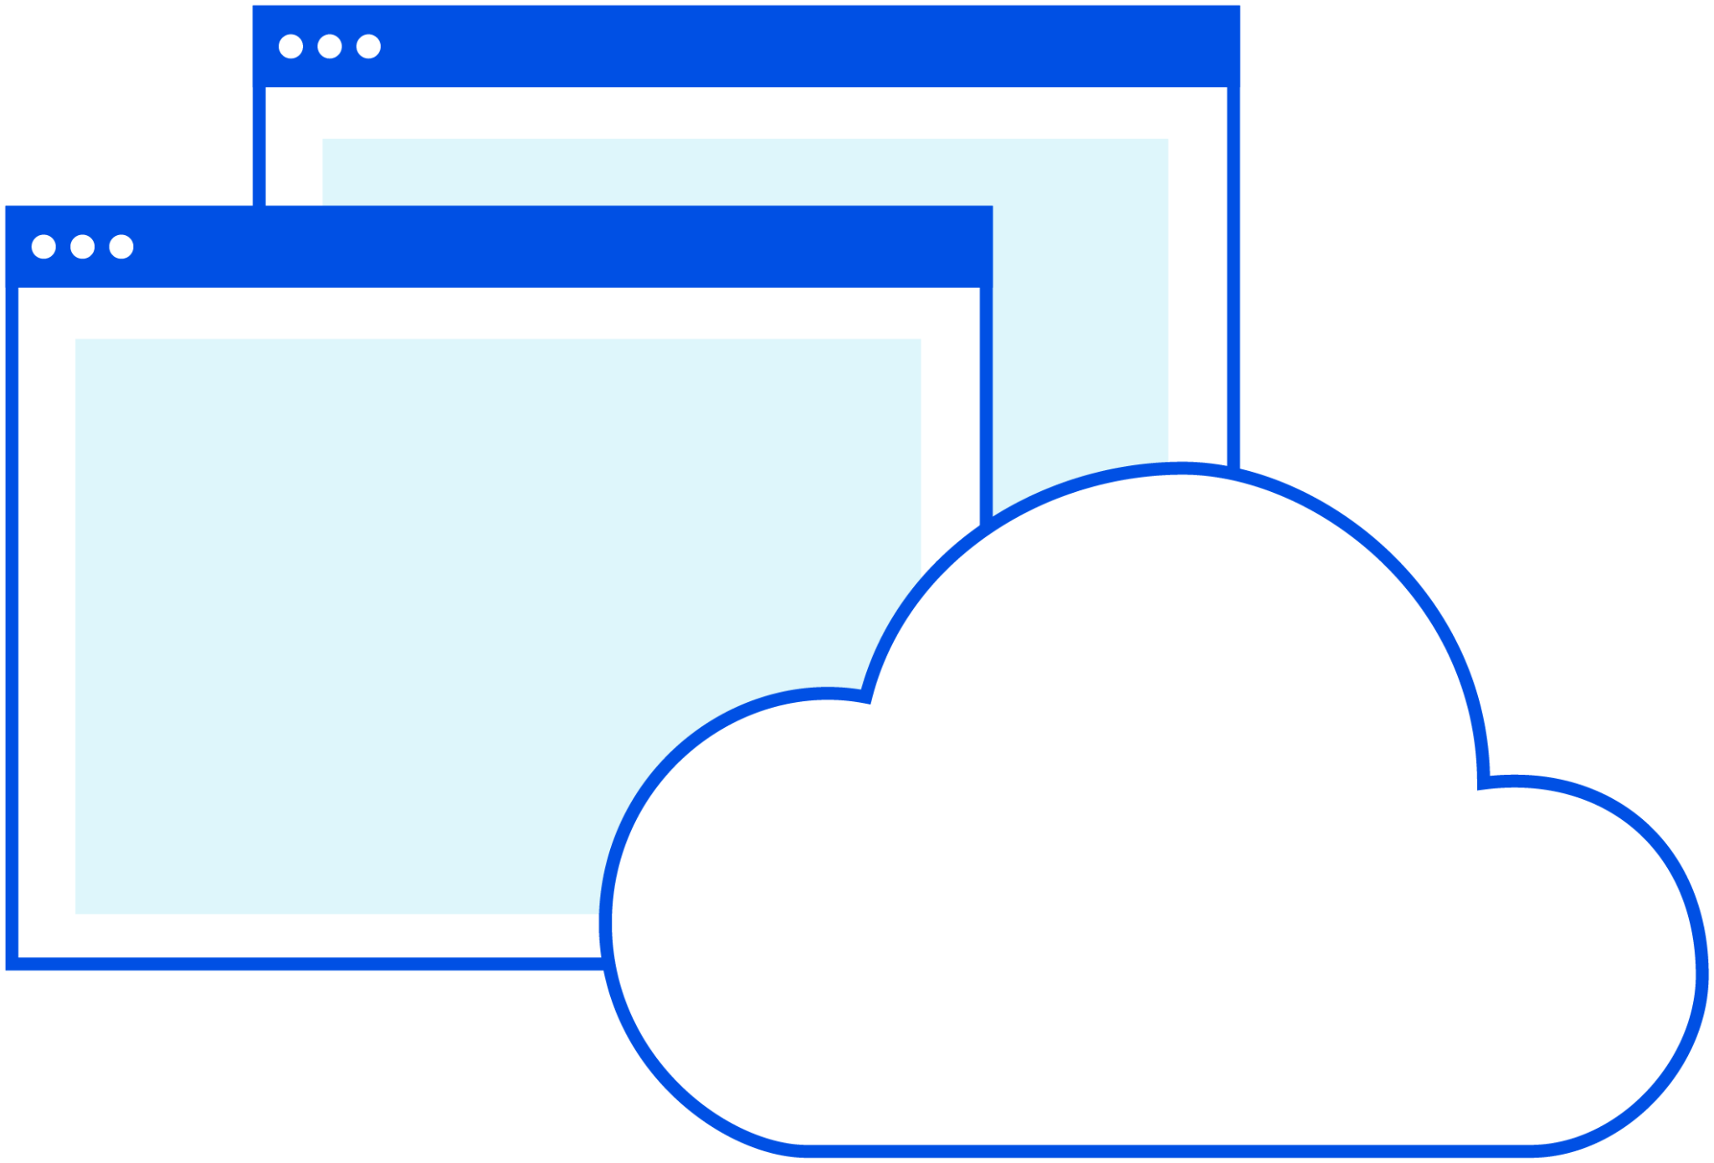
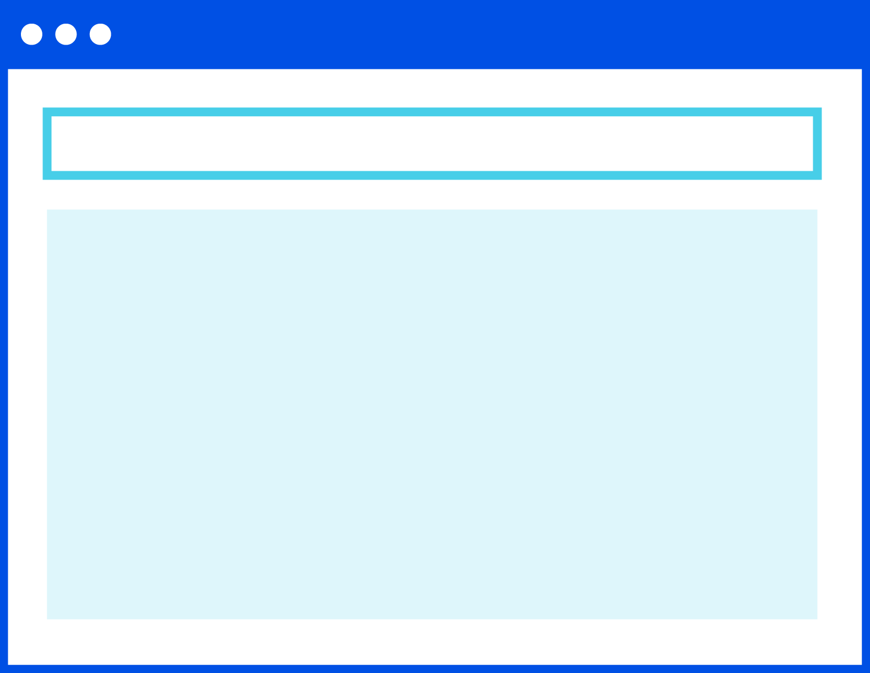
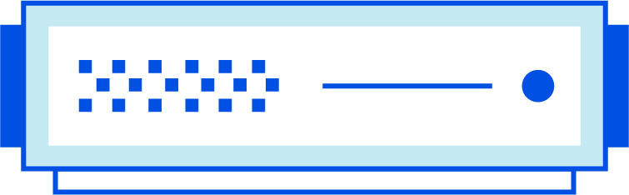
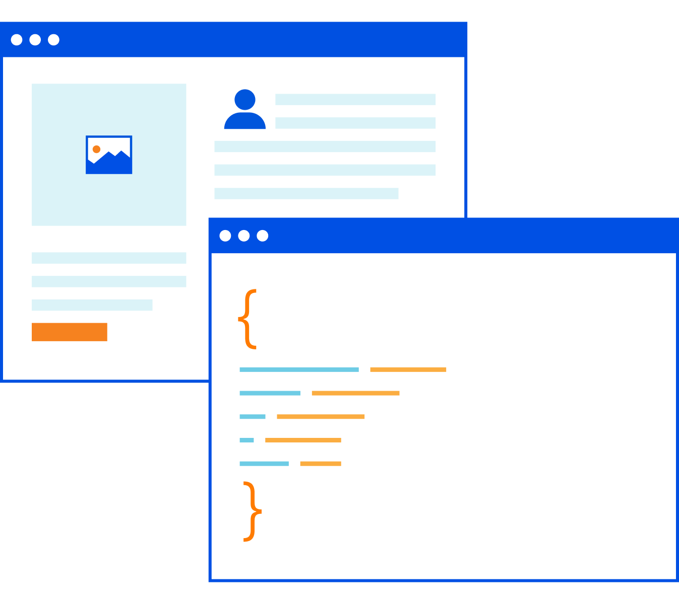
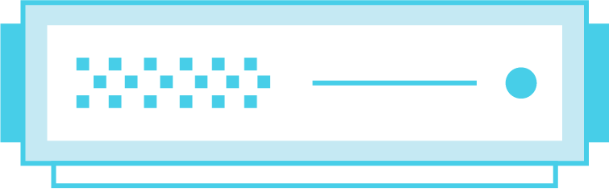
Zero Trust Browsing
Cloudflare One: Zero Trust services
[cost-efficient innovation] Perfected Internet security, fixes SWG policies that are too restrictive, or too relaxed
[ease of use] Works on any website, any browser, with a better user experience than local browsing
[network speed & scale] A global solution delivered
from a global network
Known web exploits
Zero-day web exploits
Untrusted code safely executed in
headless browser
Zero Trust draw commands
Untrusted code
User browser
Website
Zero Trust Network Access
Secure Web Gateway
Firewall as a Service
WAN as a Service
Browser Isolation | DDoS Protection
Notes:
Slide goals:
- Browser Isolation overview
- Explores how we’re better and faster
Core pitch talk track [158 words, 1 minute]
The reality is that filters and inspections will never prevent or detect 100% of threats even with the best intelligence.
And you trying to block every site that could possibly pose a risk to employees is likely to cause more damage in lost productivity..
Our Remote Browser Isolation runs a headless version of the Chromium browser at our edge, which renders all browser code, instead of your endpoints, to mitigate known and unknown threats.
It also shields application data viewed in their browser from malware-infected devices.
It’s not a standalone point solution; it’s natively built into the same policy builder and device client that you use for our gateway and access services.
Most companies have hit roadblocks attempting to deploy this technology because it’s been too slow, too expensive, and ultimately ineffective at isolating attacks.
Our approach is different from every other vendor and renders an experience that’s just as fast as local browsing without breaking any site.
More notes:
Soon, we’ll add in-browser controls to allow you to secure data in use within web browsers; starting with functions like copy/paste/print, and eventually limiting keyboard input or form fields.

Slide 13
And adds Zero Trust Browsing to stop data leaving any app
Cloudflare’s Zero Trust platform
[ease of use]
Natively built into the same policy builder and device client as Cloudflare Access
[network speed & scale]
End-user experience is exactly the same as local browsing
[cost-efficient innovation]
Doesn’t break apps or sacrifice performance unlike pixel pushing or page scrubbing
Control file down/upload
Block copy/paste & print
Untrusted interactions can be controlled in headless browser
Zero Trust draw commands
Sensitive data
Untrusted interactions
User browser
Any web app

Slide 14


Secure new and existing points of ingress as you transform your network
Cloudflare One: Network services
BGP route announcement
[cost-efficient innovation] Shifts your network’s attack surface to Cloudflare
[ease of use] Automatically and immediately inspects all traffic for attacks
[network speed & scale] <500ms to propagate rule updates across the globe
Ingress
Packet
Customer
Network
L3 DDoS protection
express data path in the Linux kernel uses logic and filters to mitigate attacks in <3s
Anycast GRE tunnel
Branch office with DIA
DDoS
attack
L3-4 firewall rules
protocol, source or destination IP & port, packet length, bit field match
250+ cities
Data center at corp HQ
Network interconnect
Good
traffic
direct or virtual via partner to eliminate internet hop
Data center at shared co-lo
Secure Web Gateway
Firewall as a Service
WAN as a Service
Zero Trust Network Access
Browser Isolation | DDoS Protection
Notes:
Slide goals
Magic Transit overview
Explore how we're better
Core pitch talk track [161 words, 1 minute]
Moving on to the second half of your journey to SASE, Cloudflare offers multiple traffic onramps to our network.
Unlike most SD-WAN vendors, one method is using BGP to announce your networks’ prefixes from every single Cloudflare PoP to ingest traffic closest to its origin.
Our DoS mitigation systems and network firewall are built into every data center across our edge to isolate your network from attacks and inspect traffic at line rate.
Only clean traffic is then off-ramped to your network using either Anycast GRE tunnels or private network interconnect.
You build one GRE tunnel to Cloudflare using a standard router at your branch office or data center, then we apply Anycast routing at layer 3 to magically terminate this tunnel at over 250 locations with built in health checks to deliver unprecedented resilience.
Even better, if your data center resides in over 1600 colos with either our data centers or our cloud-exchange partners, we can skip the internet and directly exchange traffic.
More notes
We’re not selling customers a firewall or a DDoS appliance in the cloud — we’re selling an edge network with the firewall and DoS mitigation built inside it already.

Slide 15
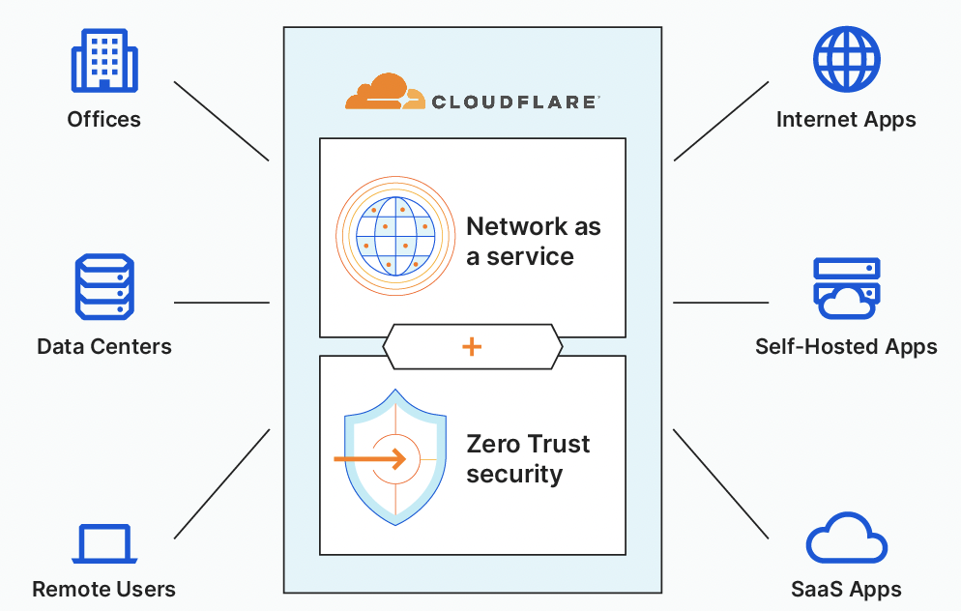
Extend Zero Trust networking by connecting offices and data centers
Cloudflare One: Network services
[network speed & speed]
Single-pass inspection for secure, fast, reliable, private connectivity
[ease of use] Single-pane management unifies network as a service and Zero Trust security
[cost-efficient innovation] Reduced spend on private network links and appliances
Zero Trust Network Access
Secure Web Gateway
Firewall as a Service
WAN as a Service
Browser Isolation | DDoS Protection
Notes:
Slide goals
Magic WAN overview
Show that WAN as a service goes beyond SD-WAN and works with existing solution
Can skip SD-WAN by over-provisioning broadband links at branch offices
Core pitch talk track (158 words, 1:05 minute)
You can use that same router-based tunnel or colo-based interconnect to secure egress traffic to any app.
And our WAN as a service will transport and accelerate traffic East-West between your branch offices and data centers, plus remote users and multicloud environments.
Today, a patchwork of MPLS and private cloud links plus VPN and network security appliances are required meet your security and performance needs.
By using Cloudflare, the Internet becomes your corporate network with unified private routing, network security, and Zero Trust built-in.
You gain fine-grained control over what data is allowed in and out of your network with one policy managed from one dashboard or our programmable interface.
Unlike traditional SD-WAN solutions that require deploying new on-prem connectors, simply use your existing on-prem equipment.
Already have such SD-WAN connectors? Great, our network onramp partners point your traffic to Cloudflare’s edge.
Either way, you’ll magically gain a full WAN mesh with the same performance as private circuits.
More notes

Slide 16
Optional Demo
Partner portal demo
Cloudflare One

Slide 17

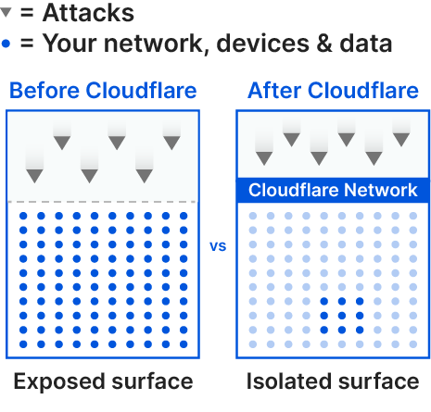

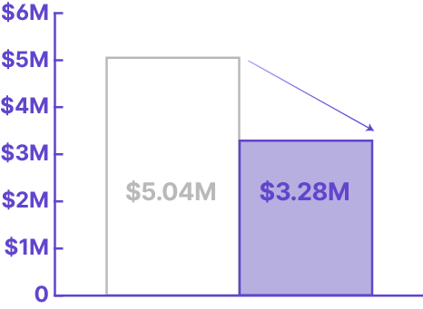
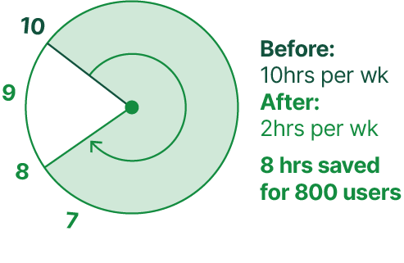
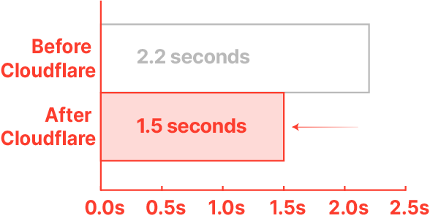
Why Cloudflare
The ROI of Zero Trust
5 ways Zero Trust security modernization saves your business time and money
1.
Reduce
attack surface
2.
Reduce
breach costs
3.
Accelerate onboarding
4.
Reduce
IT tickets
5.
Reduce
latency
91%
35%
60%
80%
30%
Notes:
If you’re an IT leader, you’ll measure on average a 80% reduction of time spent resolving IT tickets and security posture for your remote workers. If you’re a security leader, you’ll implement a 91% reduction to your attack surface by Cloudflare isolating application access and internet browsing from a variety of breach risks.
Zero Trust is a journey, not a single product, but our platform makes the first two steps so simple to realize the promised value from this new positive security model.

Slide 18

Why Cloudflare
The ROI of SASE
2 ways SASE network transformation saves your business time and money
10→1
Replace ten point products with one composable platform — Cloudflare One is easier to deploy and addresses more needs than solutions stitched together across many vendors. Reduce operational costs by managing your WAN and network security through a single dashboard.
↓95%
Cloudflare One uses our edge to stop any size network-level threat at wire speed, and places our edge between users and their application access and internet browsing to reduce attack surface and shorten remediation times (note: Gartner estimates up to 95% by adopting SASE).
Improve business agility and save on cost
Reduce your attack surface

Slide 19
Why Cloudflare
Network speed and scale
We have faster, intel-driven routing via more interconnects to and across our edge, which verifies, filters, isolates, and inspects traffic in one pass for a faster user experience.
Cost-efficient innovation
Replace a patchwork of proprietary circuits, network appliances, and security solutions with one solution equipped to handle the realities of cloud, mobility and digital transformation
Ease of use
Our platform was built from scratch with end user experience in mind. It deploys faster with quicker time-to-value than others’ lift-and-shift or acquire- and-stitch approaches.

Slide 20
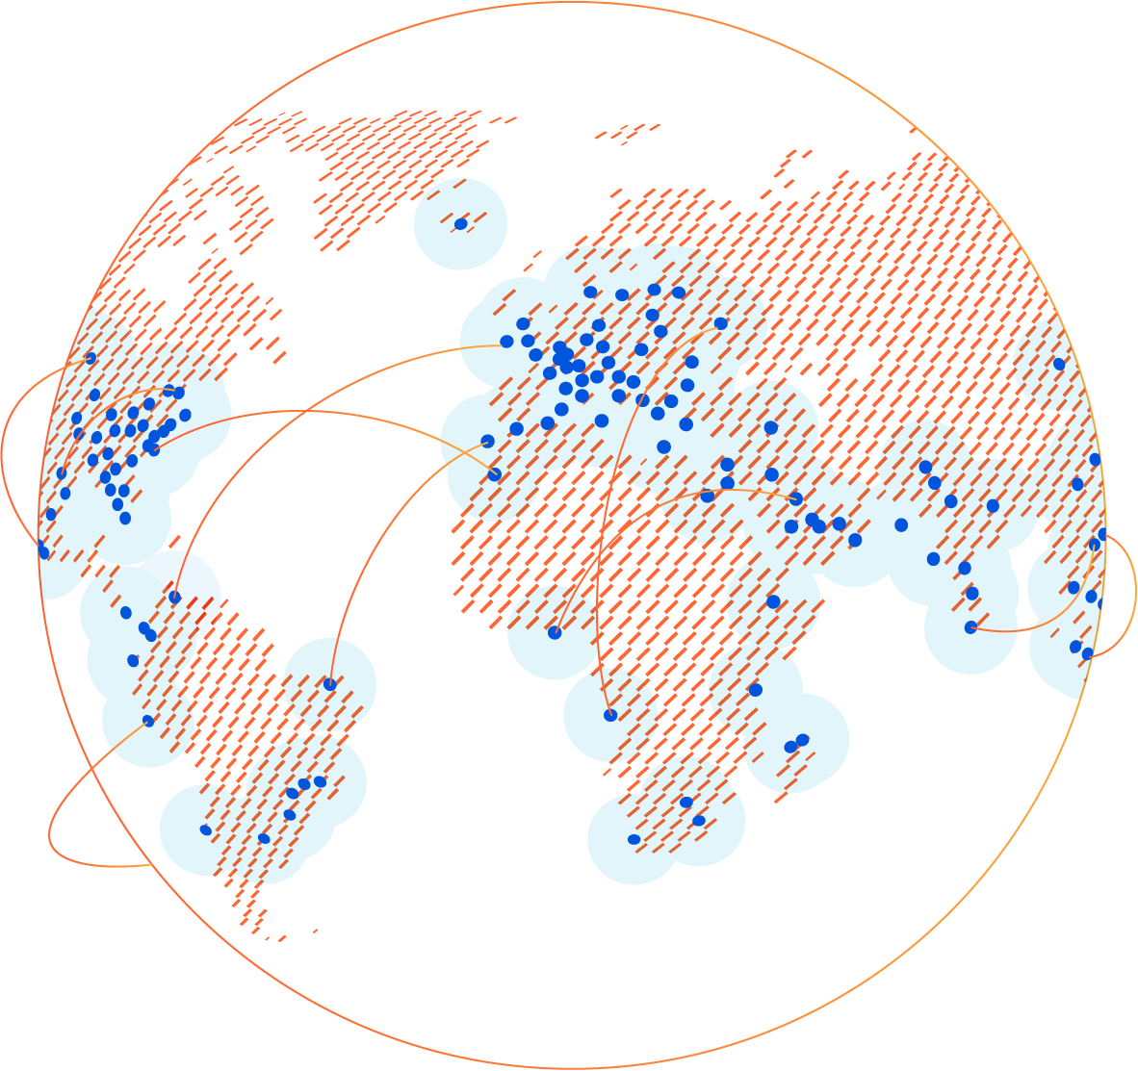
Let’s get started
Cloudflare One
Ready to transform your network with Cloudflare One?
Start a proof of concept with your account team today.
Notes:
Slide goal:
Close the presentation
Ask if they’re ready to set up a demo, proof of concept, or architecture workshop/discussion
Core pitch talk track [59 words; 0:25 minute]
Cloudflare is democratizing SASE to be simple for any size business to adopt, which is why we offer many of these capabilities in our Free Plan.
And we’d love to start you on a proof of concept with all enterprise capabilities enabled, and helping you get started with use cases that don’t require any changes to your existing environment.
More notes:

Slide 21
Thank you
Cloudflare One

